Slide 1
Shallow Neural Networks
Dai Bui

Slide 2
Activation Functions

Slide 3
Activation Functions

Slide 4
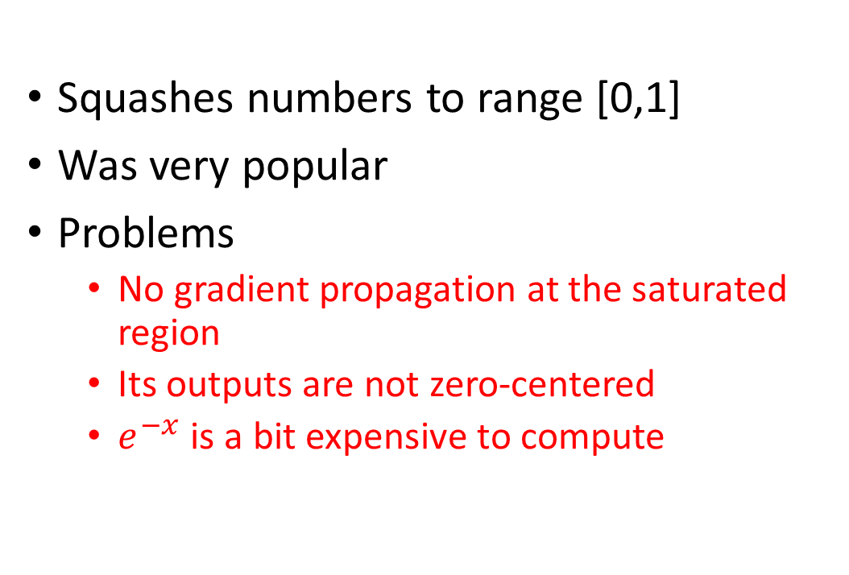

Activation Functions: Sigmoid
$$σ\left(x\right)=\frac{1}{1+e^{−x}}$$
Squashes numbers to range [0,1]
Was very popular
Problems
No gradient propagation at the saturated region
Its outputs are not zero-centered
$e^{−x}$ is a bit expensive to compute

Slide 5
Activation Functions: Tanh
Squashes numbers to range [0,1]
Zero-centered
No gradient propagation at the saturated region

Slide 6
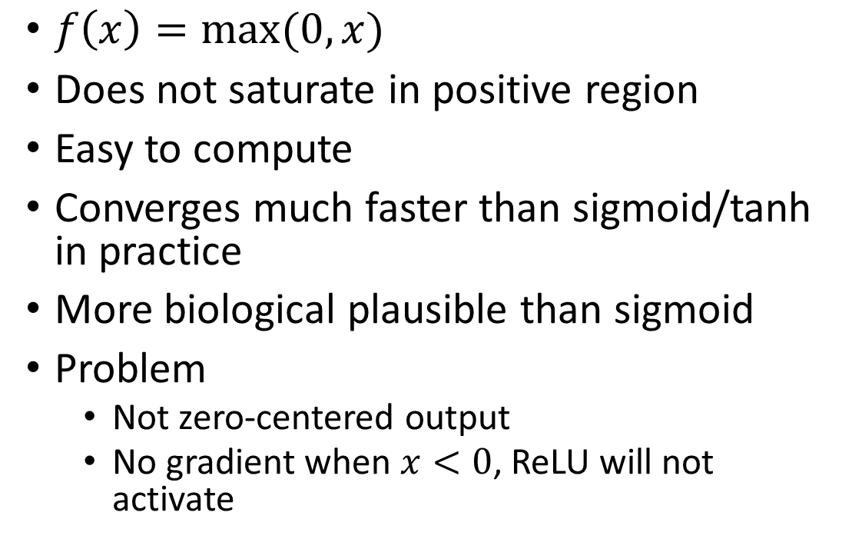
Activation Functions: ReLU
$f\left(x\right)=\max{(0,x)}$
Does not saturate in positive region
Easy to compute
Converges much faster than sigmoid/tanh in practice
More biological plausible than sigmoid
Problem
Not zero-centered output
No gradient when $x<0$, ReLU will not activate

Slide 7
Activation Functions: Leaky ReLU
Does not saturate in positive region
Easy to compute
Converges much faster than sigmoid/tanh in practice
More biological plausible than sigmoid
Will not die

Slide 8
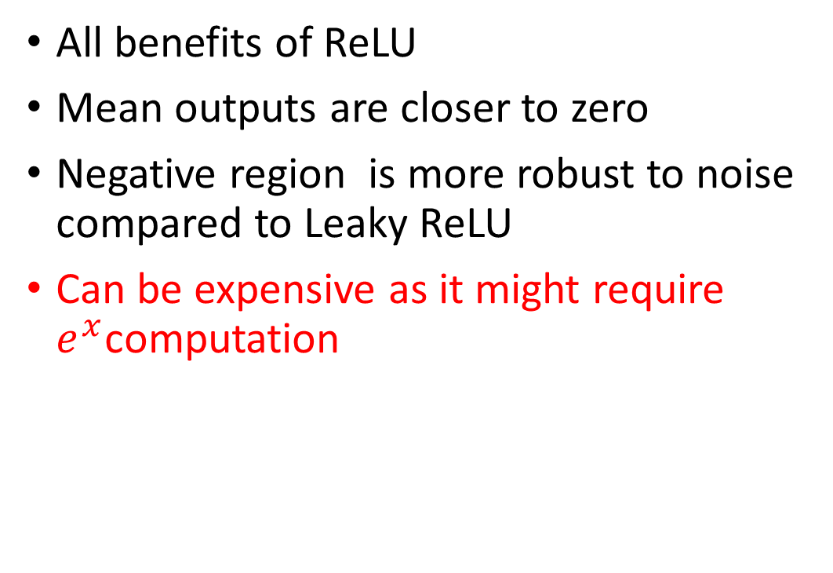
Activation Functions: Exponential Linear Units (ELU)
All benefits of ReLU
Mean outputs are closer to zero
Negative region is more robust to noise compared to Leaky ReLU
Can be expensive as it might require $e^{x}$computation

Slide 9
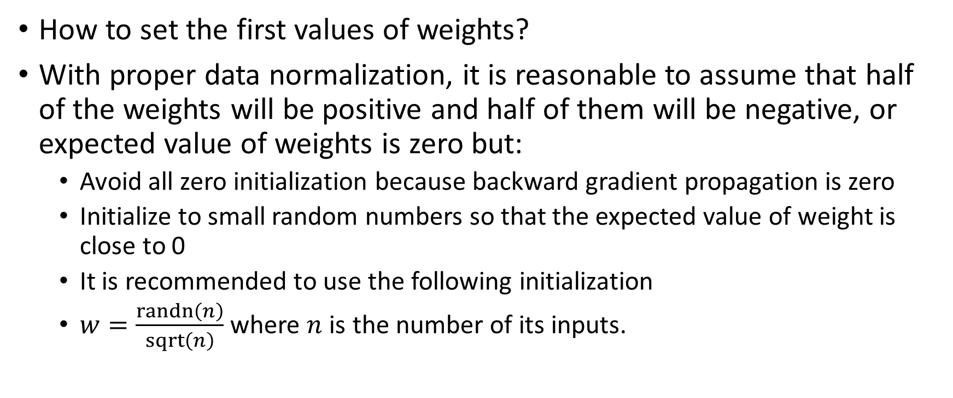
Weight Initialization
How to set the first values of weights?
With proper data normalization, it is reasonable to assume that half of the weights will be positive and half of them will be negative, or expected value of weights is zero but:
Avoid all zero initialization because backward gradient propagation is zero
Initialize to small random numbers so that the expected value of weight is close to 0
It is recommended to use the following initialization
$w=\frac{randn\left(n\right)}{sqrt\left(n\right)}$ where $n$ is the number of its inputs.

